Slide 1





Group Project
Spotify Music Analysis
Shan Jiang
Wei chen
Hangbo Li
Chang Cui
Chi Luo

Slide 2

Introduction
Spotify Music Analysis
Spotify Ltd. (/ˈspɒtɪfaɪ/) is a music streaming platform developed by Swedish company Spotify Technology, headquartered in Stockholm, Sweden and listed on the NYSE.
On Spotify's apps, music can be browsed or searched for via various parameters, such as artist, album, genre, playlist, or record label. Users can create, edit and share playlists, share tracks on social media, and make playlists with other users.
We do some basic analysis of song metadata taken from Spotify. The data contains numeric metrics generated by Spotify on the songs danceability, valence, loudness, etc. The data also contains the songs title and artist.

Slide 3
The Data
The dataset is from Kaggle, and the dataset contains 2017 songs with attributes from Spotify's API.
Each song labeled "1" means we like it and "0" for songs we don't like. We used this to data to see if we could build a classifier that could predict whether or not I would like a song.
There are 16 columns. 11 of which are song attributes, one column for song name, one for artist, and the column called "target" which is the label for the song.

Slide 4
Data Details
We analysis 11 attributes of 2017 dataset
Key | VALUE TYPE | Key | VALUE TYPE
acousticness | float | loudness | float
danceability | float | duration_ms | int
tempo | float | speechiness | float
energy | float | liveness | float
instrumentalness | float | valence | float
key | int

Slide 5
Data Details
Other 4 features of 2017 dataset
Key | VALUE TYPE
target | int
song_title | chr
artist | chr
mode | int

Slide 6
Research Questions
Spotify Music Analysis
The music has many different features, can we use these features to know that if there is a new song which someone likes it or not. We sought out to answer the following questions:
Are there specific relationships between those attributes?
Which methodology is the most accuracy one among those methodology?
Can we give someone recommendation of songs which he or she may like based on these patterns?

Slide 7
Data Analysis
Basic analysis of song metadata taken from spotify.
The data contains numeric metrics generated by spotify which measure the songs' danceability, mood, liveness, etc

Slide 8
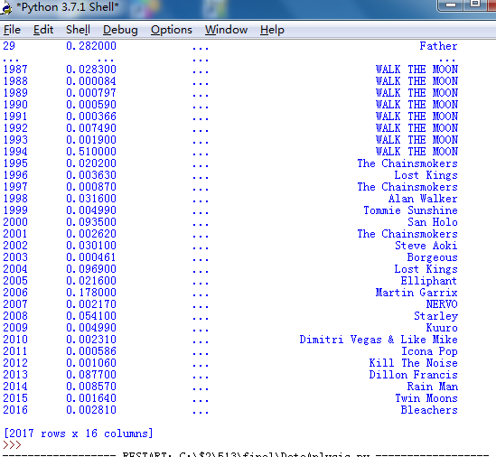
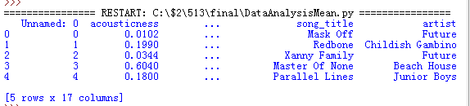
Show Data （Data & Data Head）

Slide 9
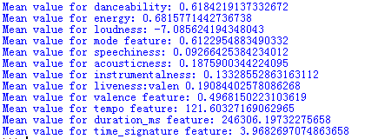
Mean Values——popular.py
All means of attritions we analized

Slide 10
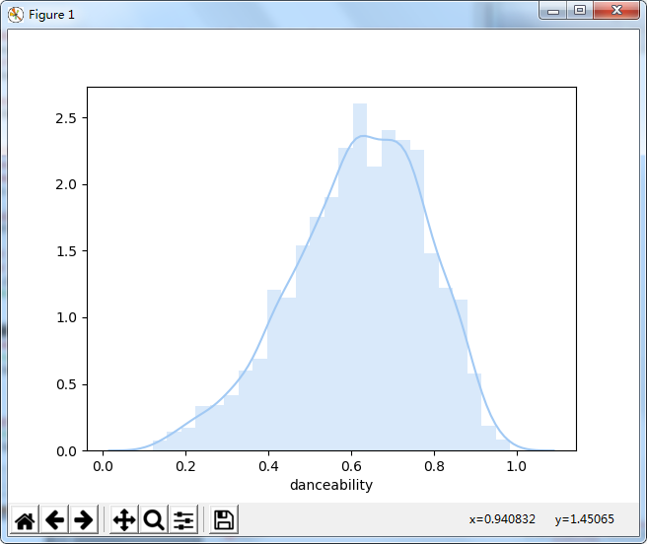
Distribution of Danceability
Danceability describes how suitable a track is for dancing.

Slide 11
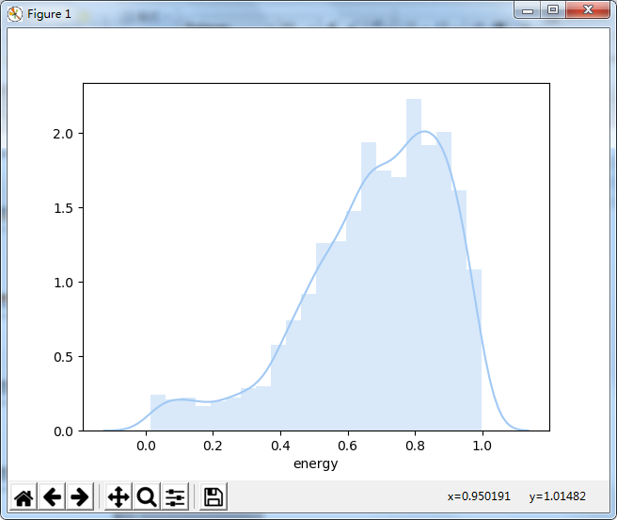
Distribution of energy
Energy is a measure from 0.0 to 1.0 and represents a perceptual measure of intensity and activity.

Slide 12
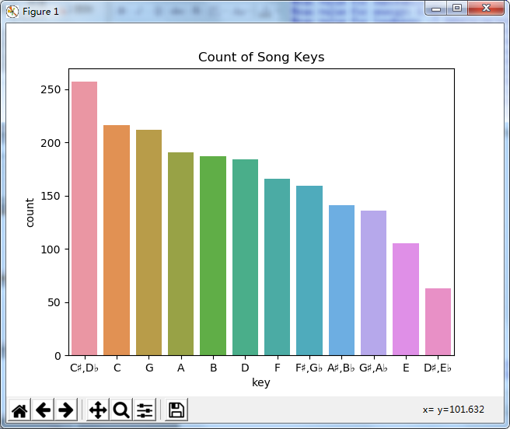
Count of song keys
Standard Pitch Class Notation

Slide 13
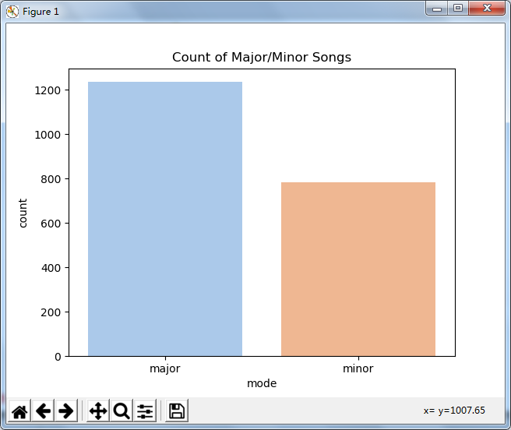
Count of Major/Minor Songs
Mode indicates the modality (major or minor) of a track, the type of scale from which its melodic content is derived. Major is represented by 1 and minor is 0.

Slide 14
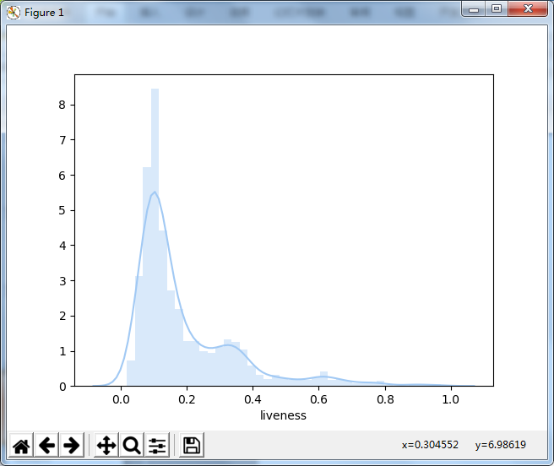
Distribution of liveness
Detects the presence of an audience in the recording.

Slide 15
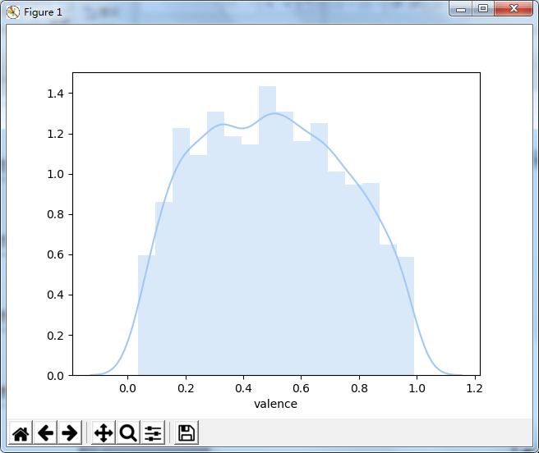
Distribution of valence
A measure from 0.0 to 1.0 describing the musical positiveness conveyed by a track.

Slide 16
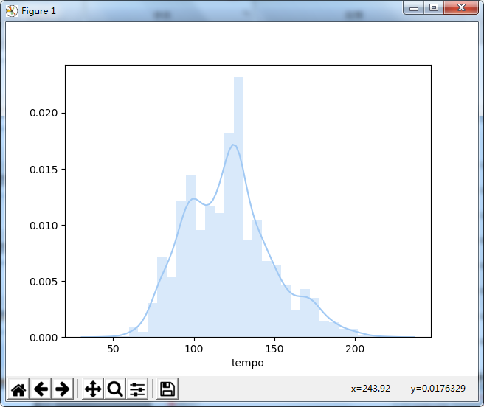
Distribution of tempo
tempo is the speed or pace of a given piece and derives directly from the average beat duration

Slide 17
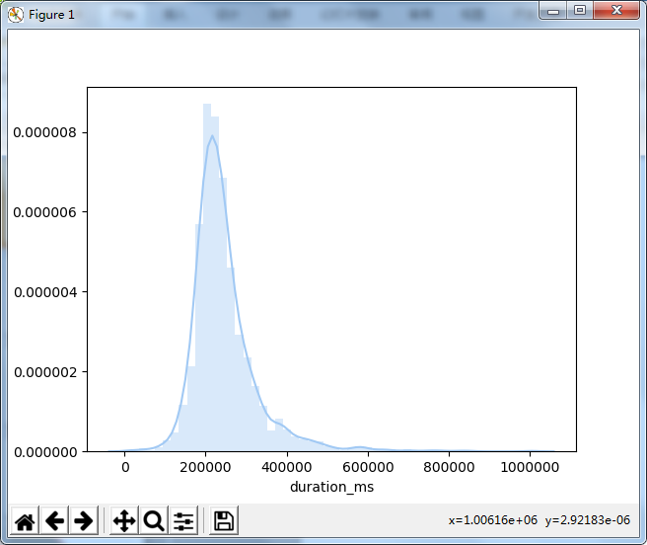
Distribution of druation_ms
The duration of the track in milliseconds.

Slide 18
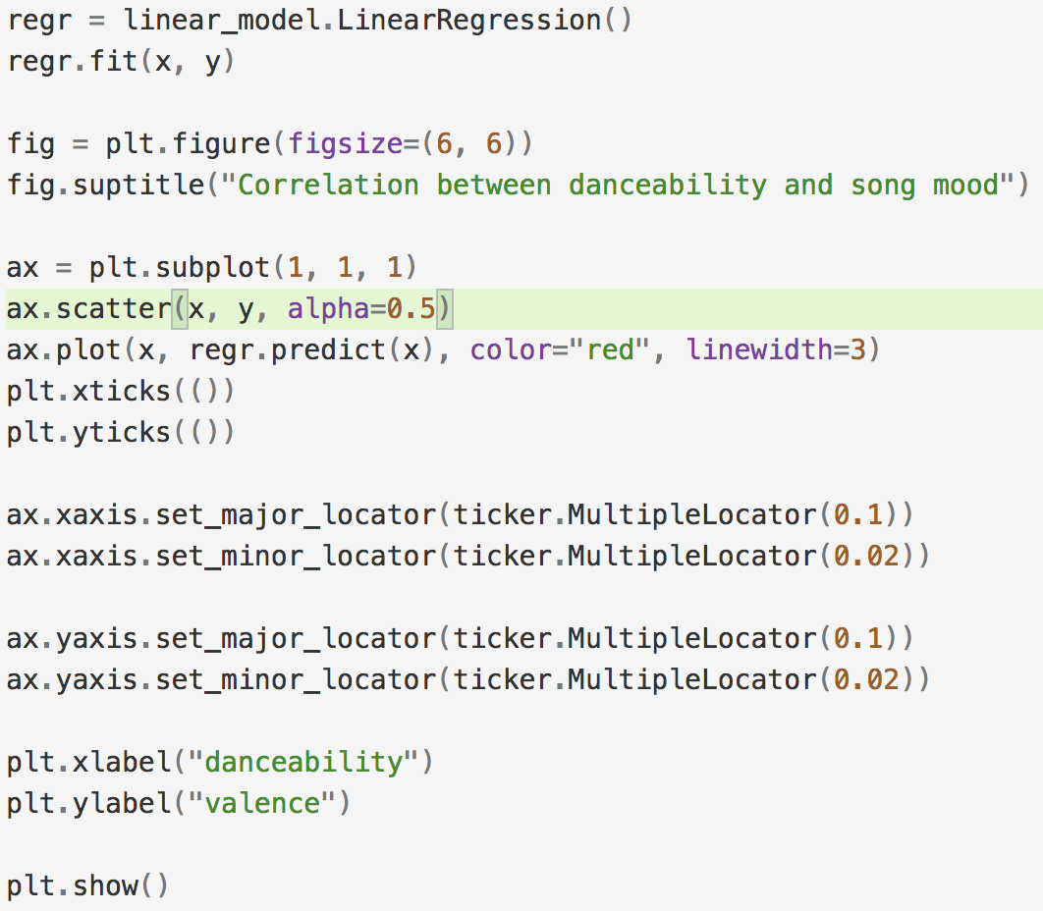
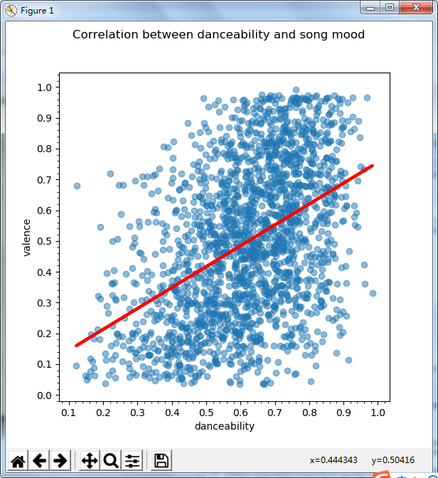
songs‘ valence and danceability values——analysis.py
First Method:
Use linearRegression to create a scatterplot with two factors valence and danceability.
The relation is shown in the graph:
Valence is in proportion to danceability
The data is accumulated/centered with the danceability in the range [0.4, 0.8]

Slide 19
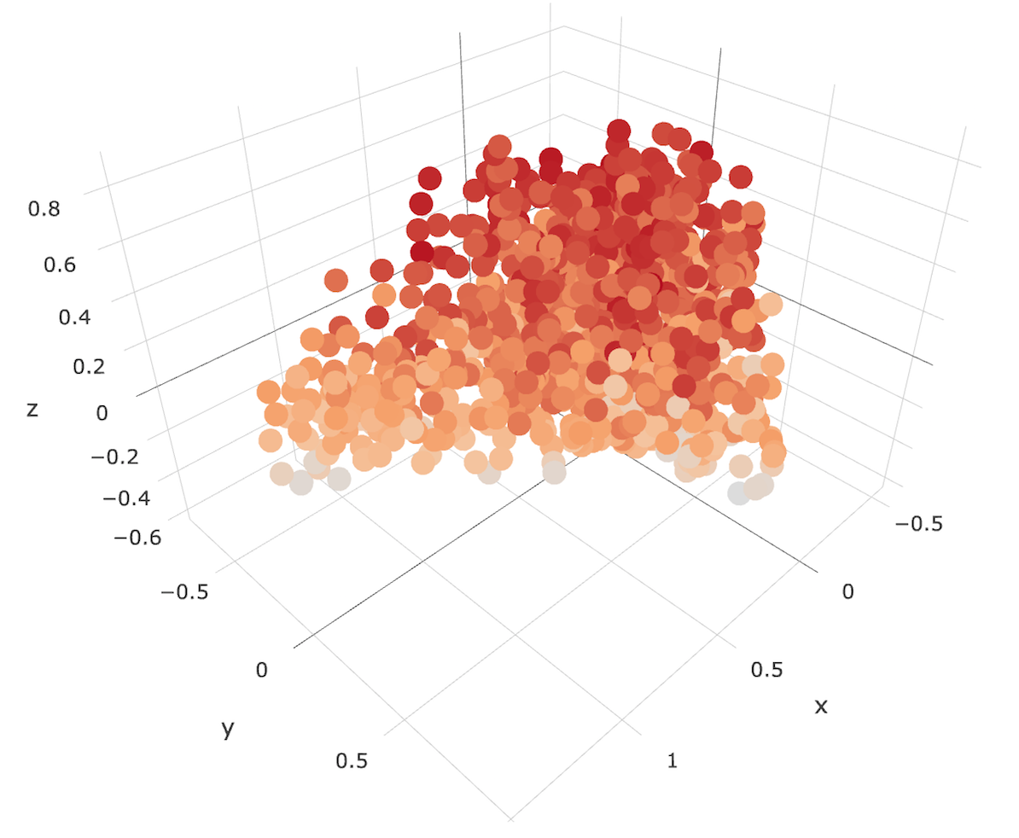
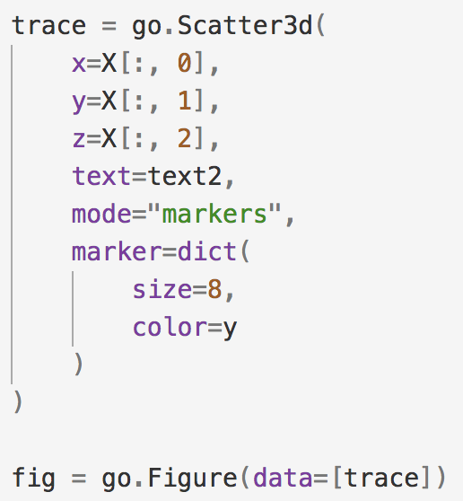
Three-dimension visualization based on 3 factors——analysis.py
generate a list of “chosen” traits and use principal component analysis to reduce the dimensions to 3
The three factors:
Energy
Liveness
Tempo

Slide 20
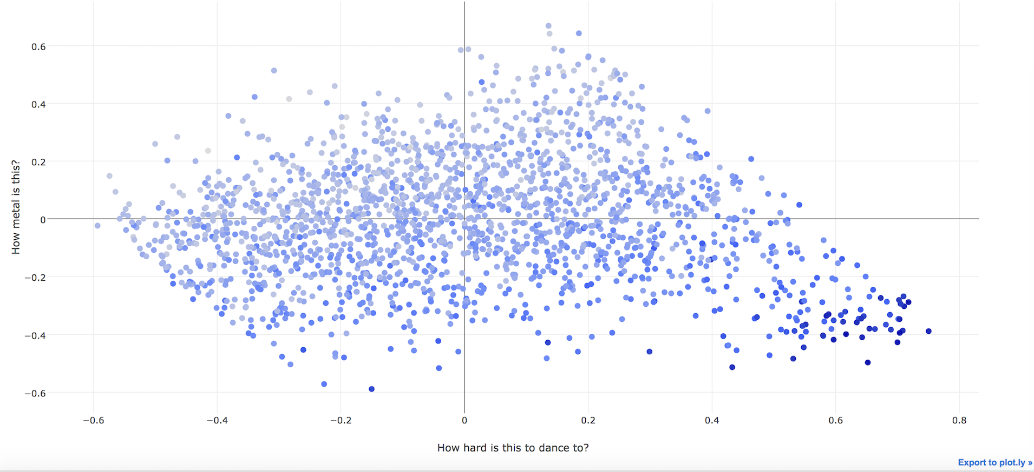
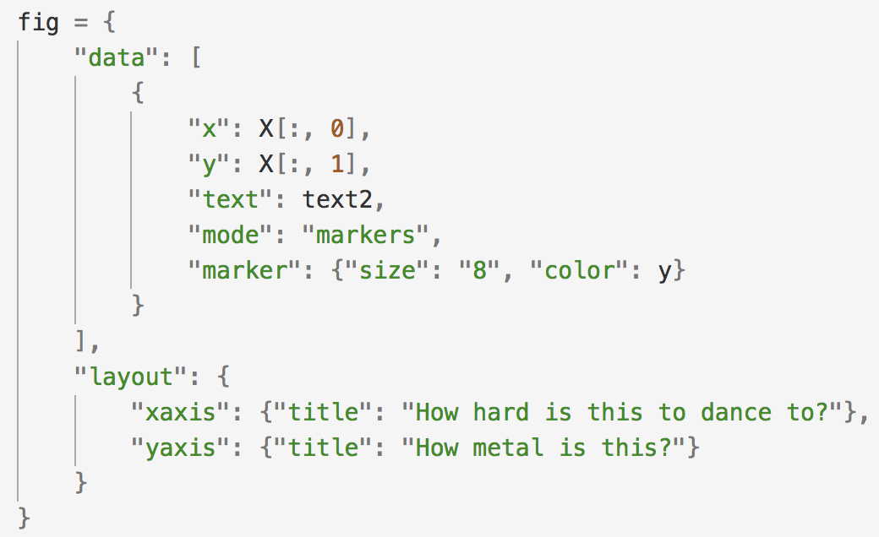
Two-dimension visualization based on 2 factors——analysis.py
Further narrow the factors into 2 to generate a two-dimention graph
Two factors:
Energy
Liveness

Slide 21
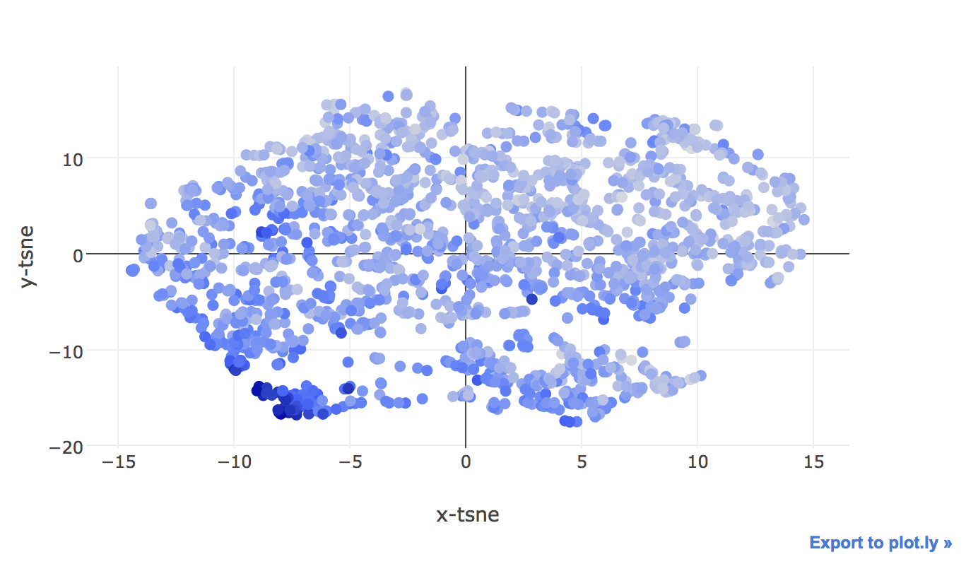
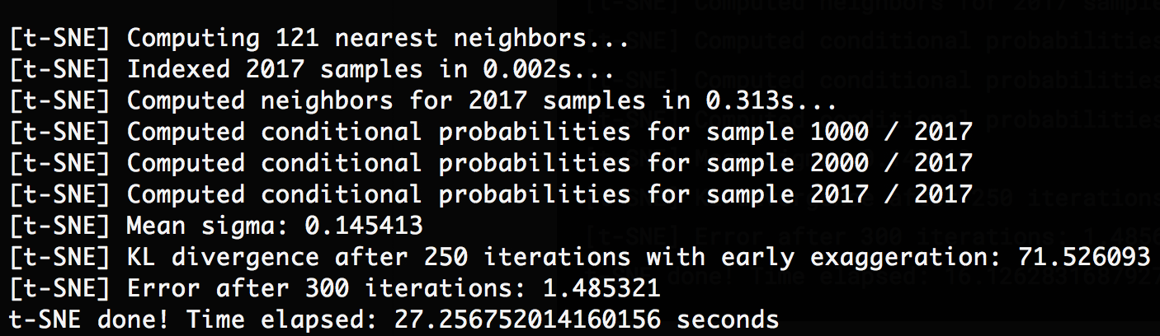
Two-dimension visualization using TSNE——analysis.py
generate a similar graph(still two-dimention) using TSNE with the same two factors in the last one:
Two factors:
Energy
Liveness

Slide 22

Methodology & Tool
Spotify Music Analysis
k-Nearest-Neighbor
Cart
C50
Neural network
Random Forest
Support Vector Machine
H-Clustering & K-Means

Slide 23
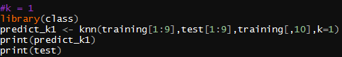
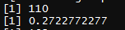
Methodology KNN
K=1
K=2
K=5
K=10
Length of test dataset: [2017/5]

Slide 24
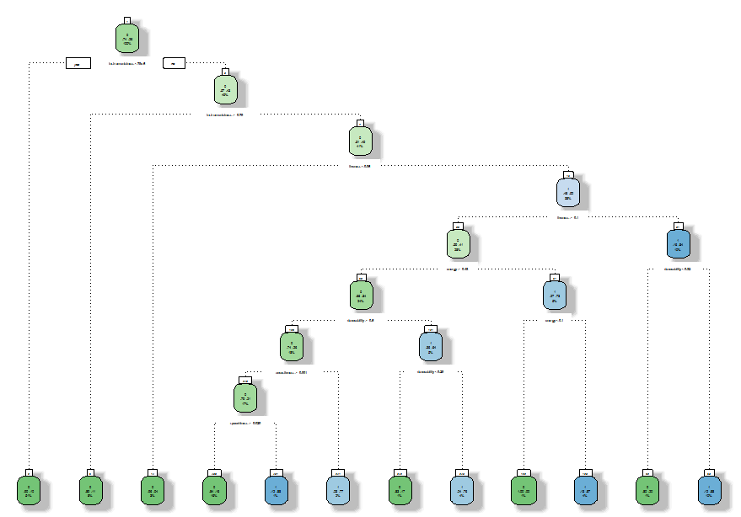
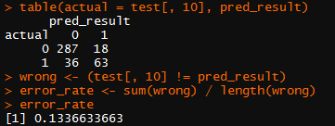
Methodology Cart
Decision Tree

Slide 25
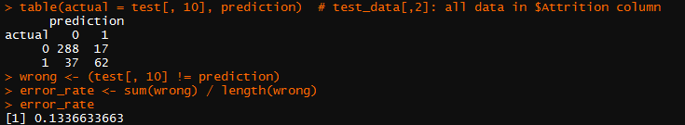
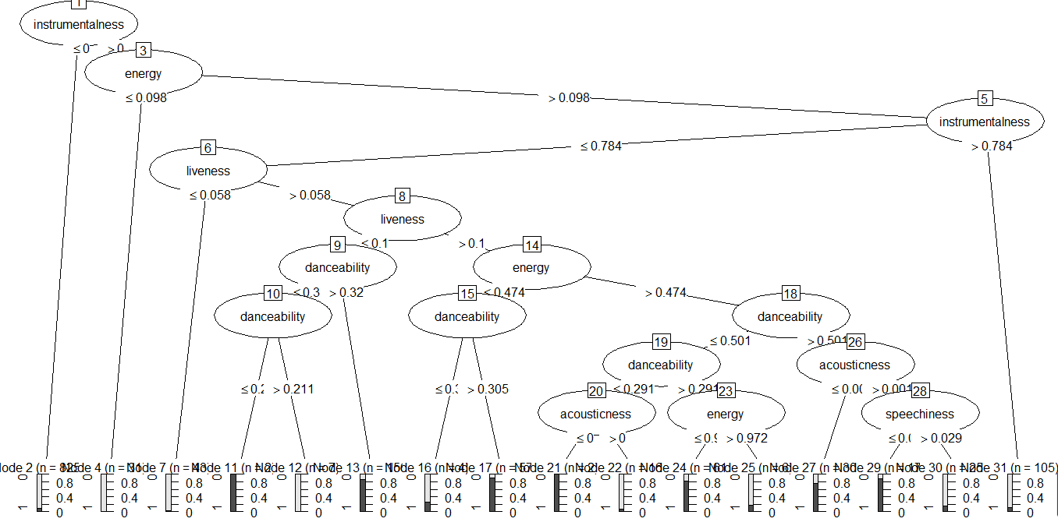
Methodology C50
Decision Tree

Slide 26
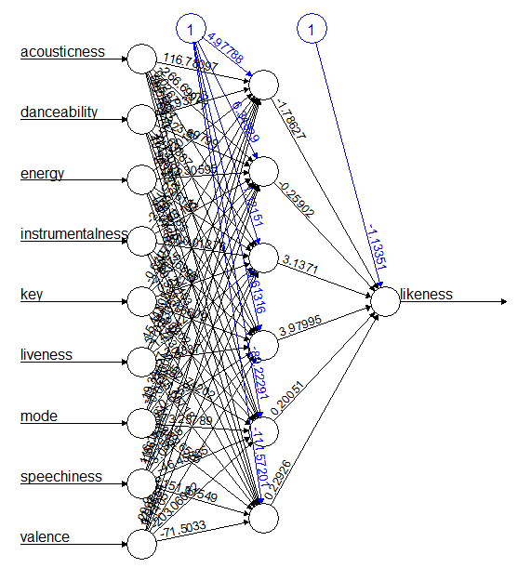
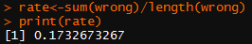
Methodology ANN —— Neural Network (single layer)
Hidden = 6 , threshold=0.01
Hidden | threshold | Error_rate
Hidden = 4 | threshold=0.01 | 0.150990099
Hidden = 10 | threshold=0.01 | 0. 1707920792
Hidden = 4 | threshold=0.005 | 0.1608910891
Hidden = 10 | threshold=0.005 | 0.1782178218

Slide 27
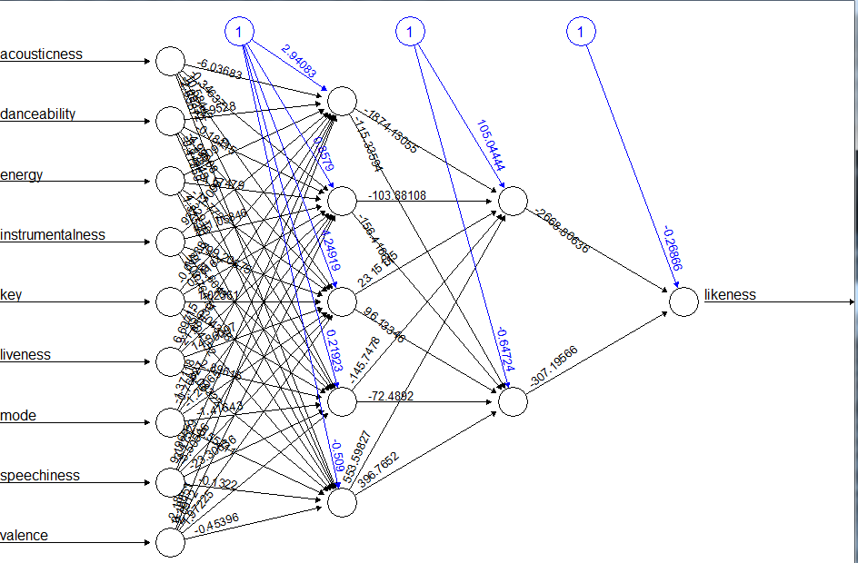
Methodology ANN —— Neural Network (double layer)
Hidden: c(5,2), c(5,3), c(5,4)
Hidden: c(5,2), threshold = 0.01
Hidden | threshold | Error_rate
c(5,2) | threshold=0.01 | 0.1732673
c(5,3) | threshold=0.01 | 0.2103960
c(5,4) | threshold=0.01 | 0.1905940

Slide 28
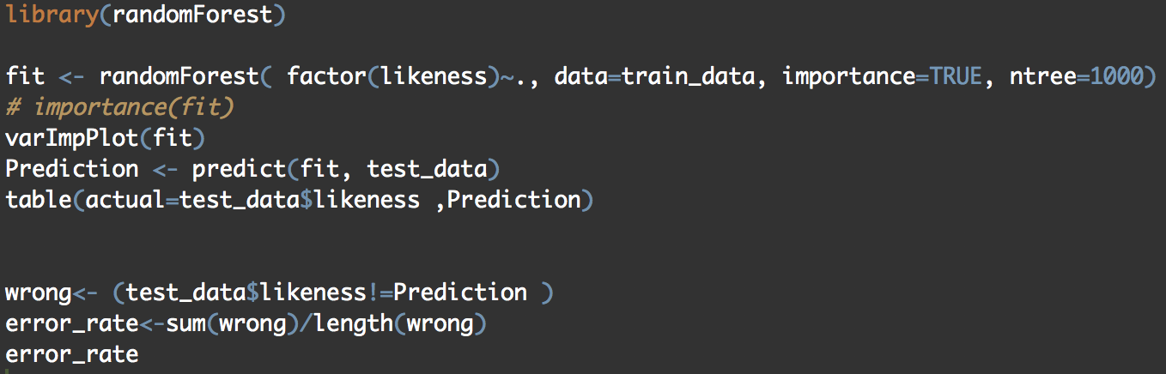
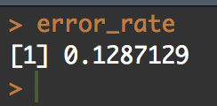
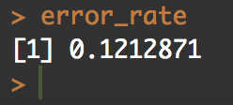
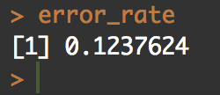
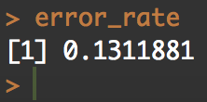
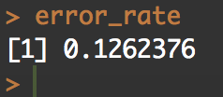
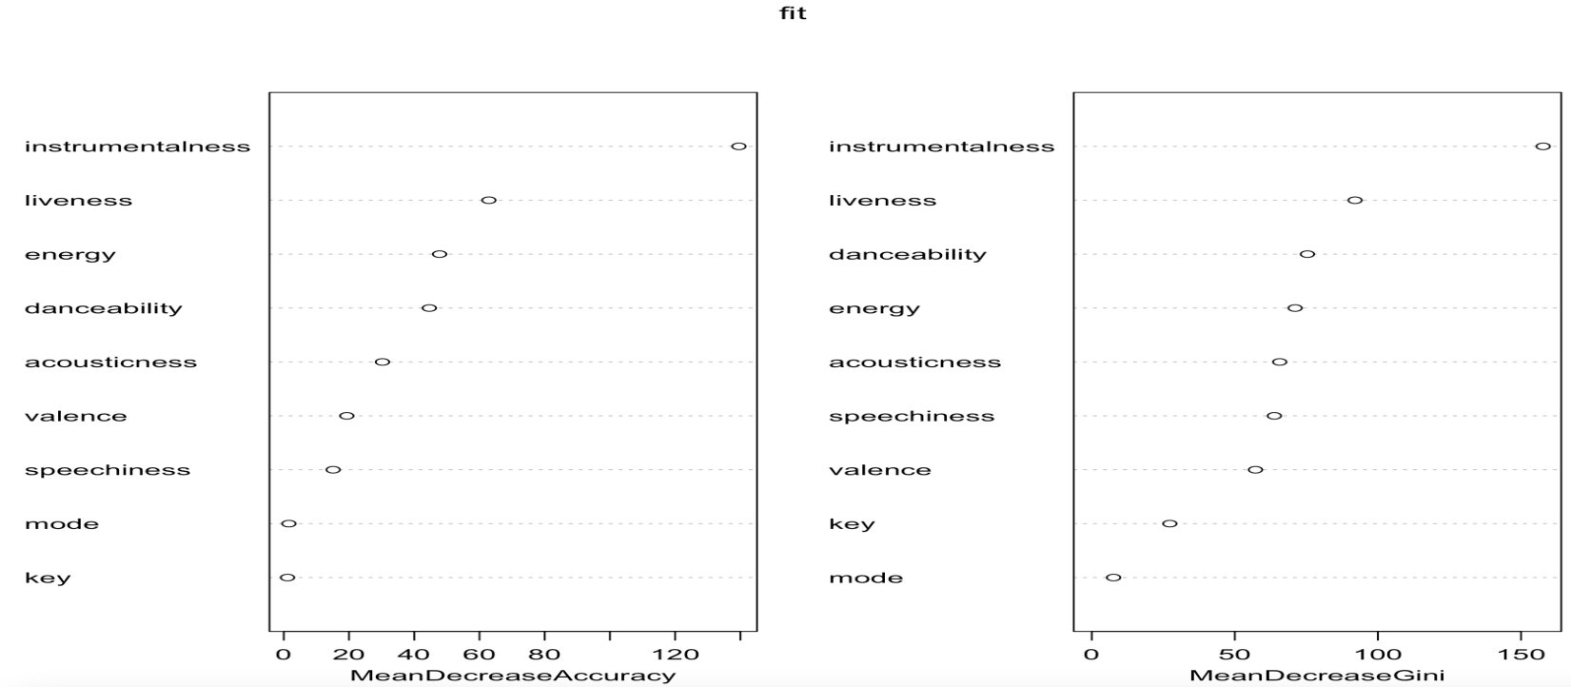
Random Forest——RF

Slide 29
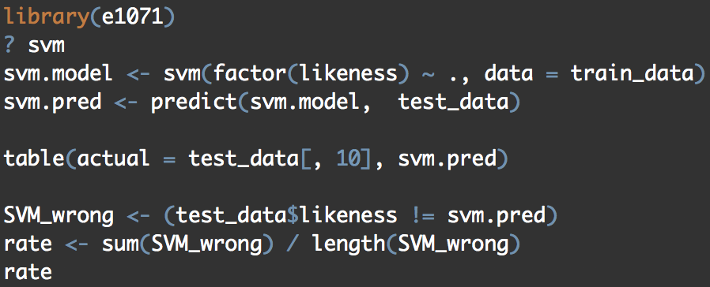
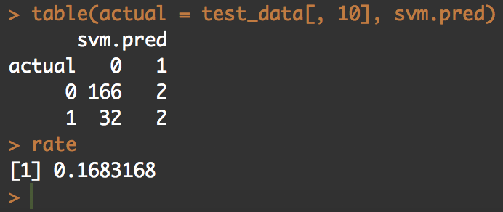
Support Vector Machines——SVM

Slide 30
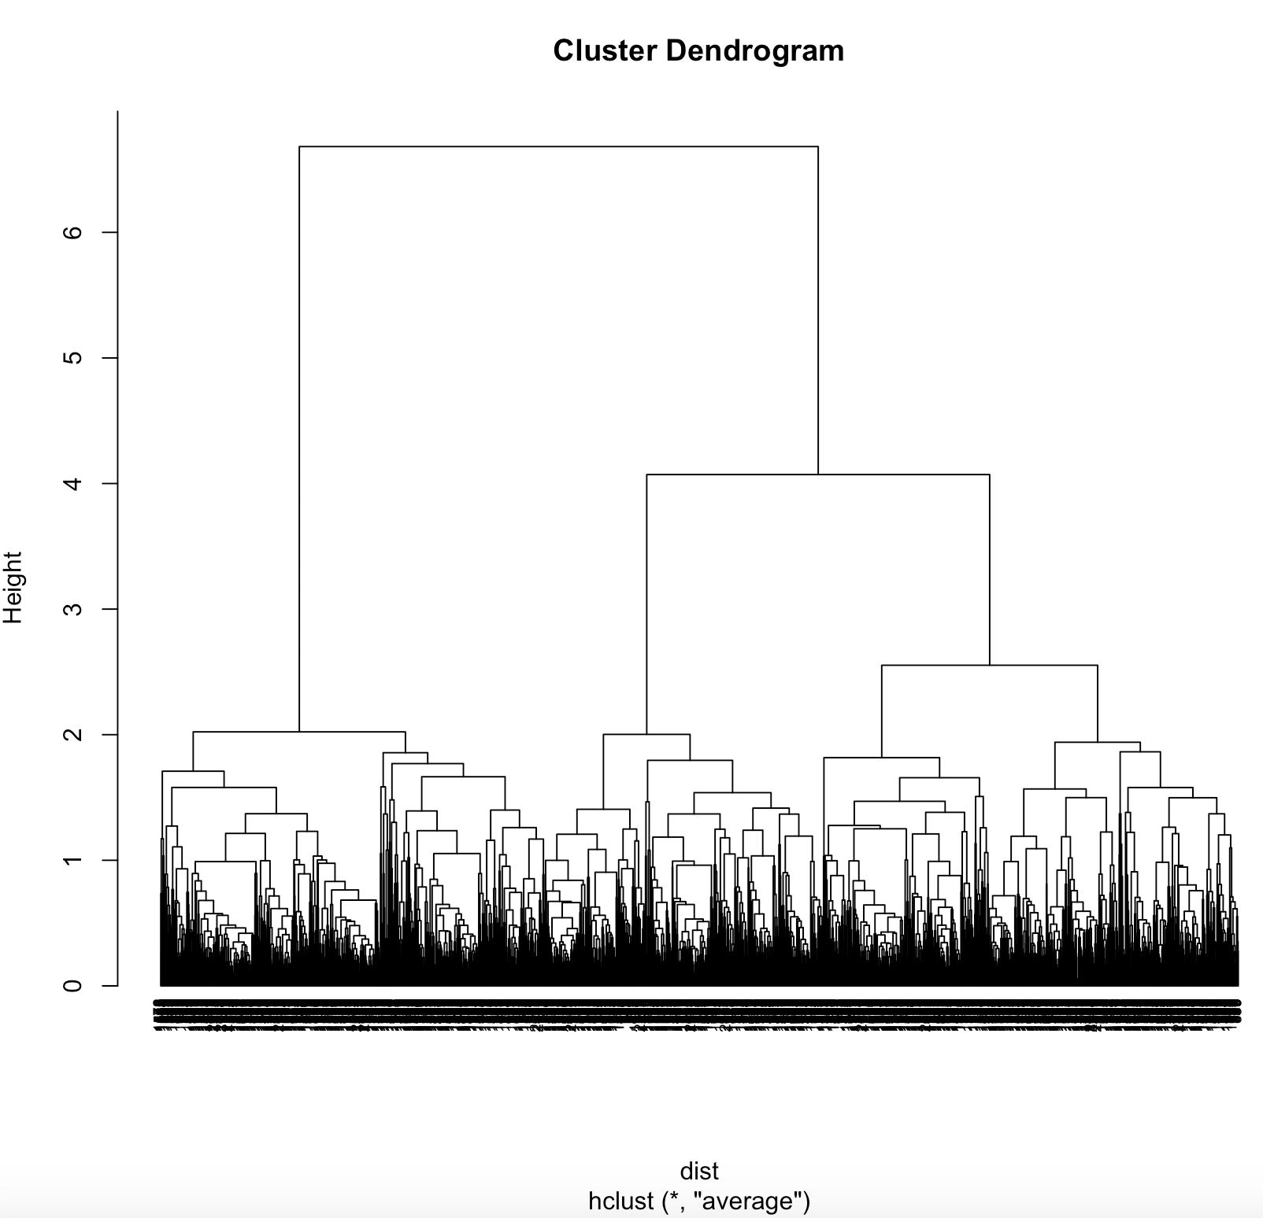
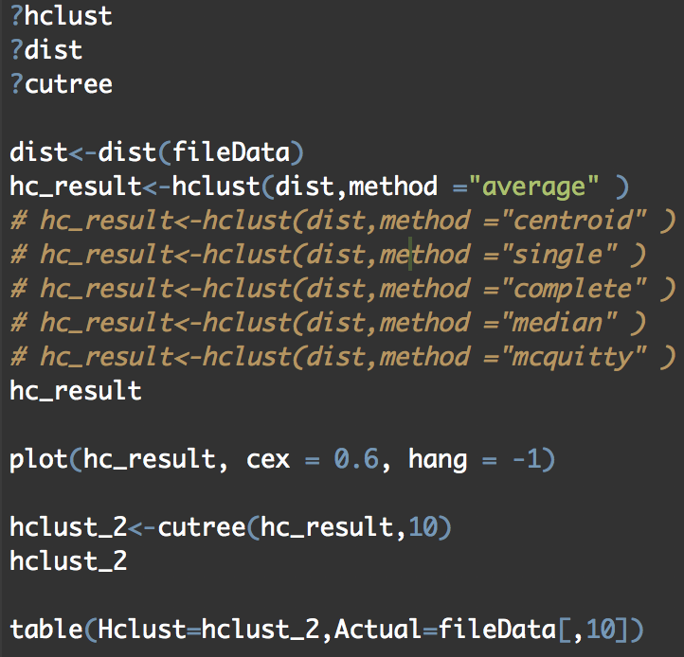
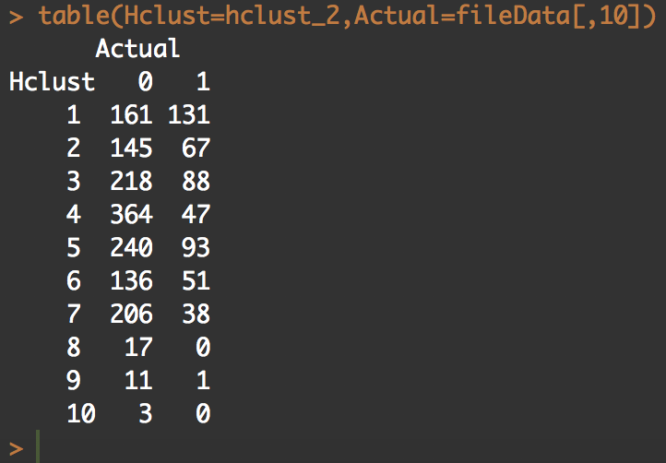
Hierarchical Clustering——hcluster
For hclust, there are many methods.
First, let‘s see
Method = “average”

Slide 31
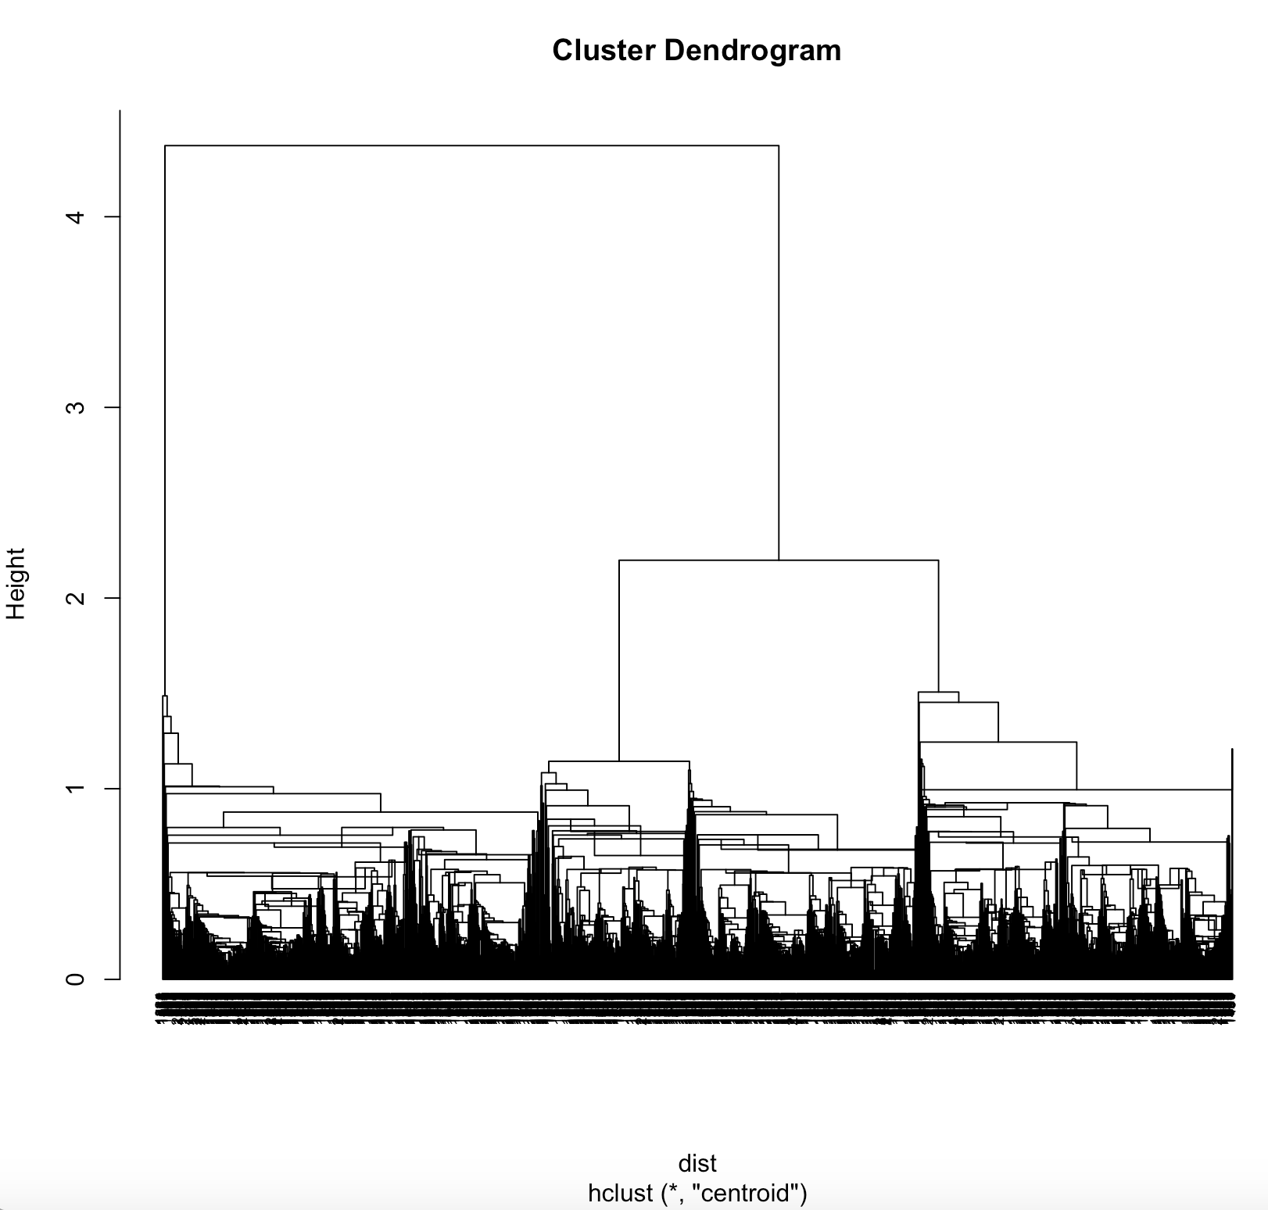
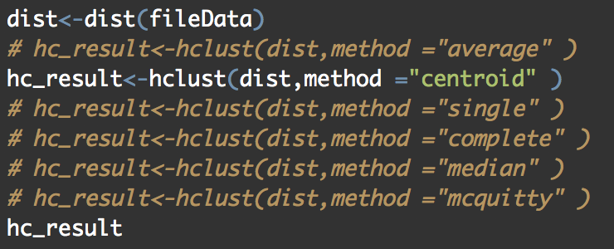
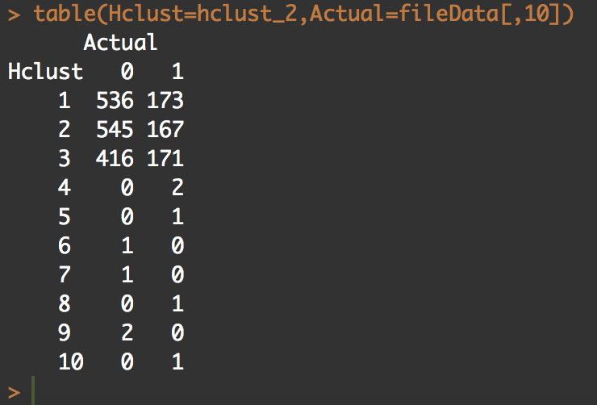
Method = “centroid”

Slide 32
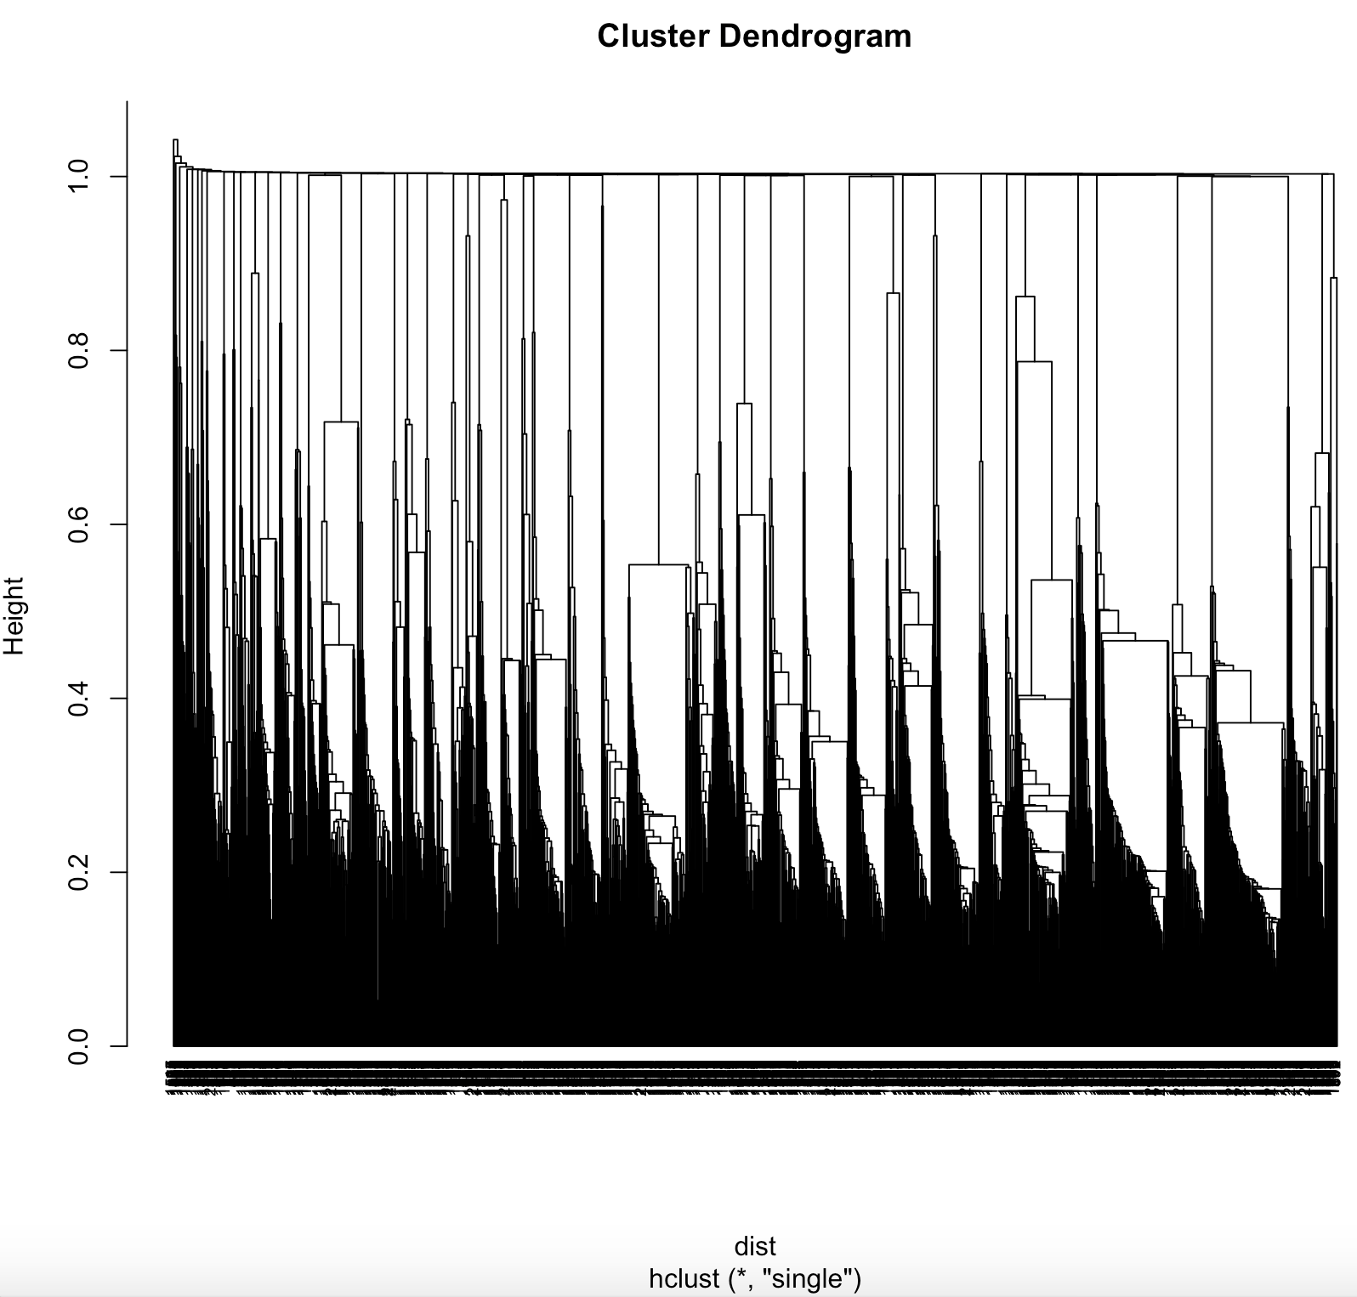
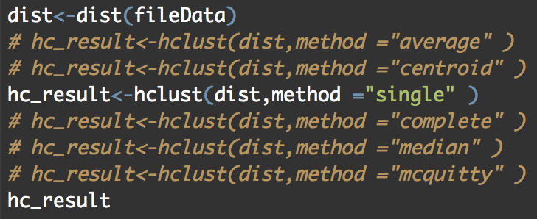
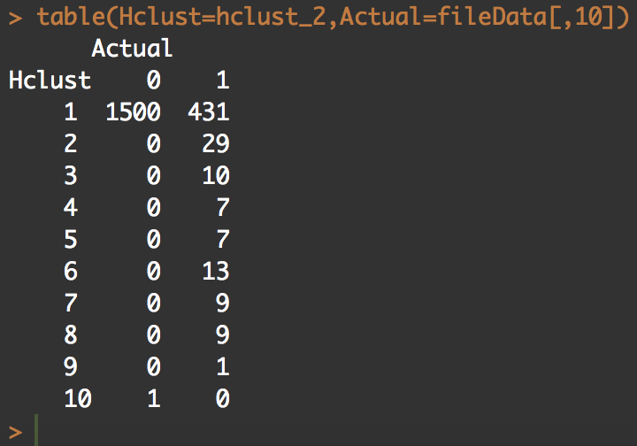
Method = “single”

Slide 33
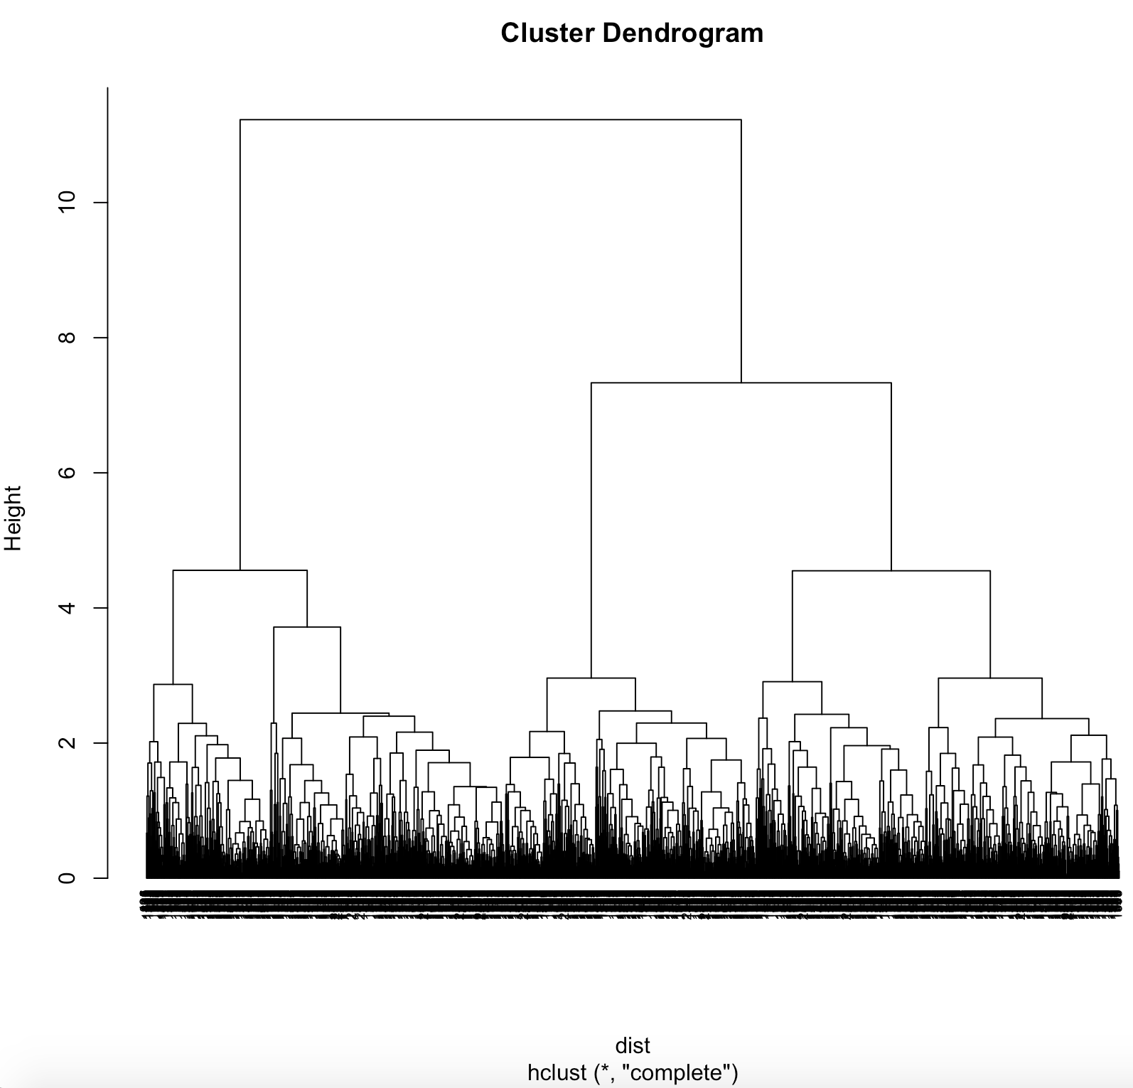
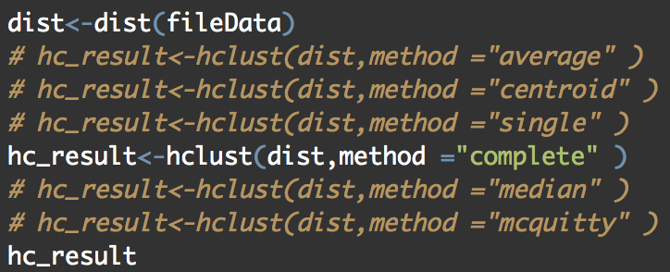
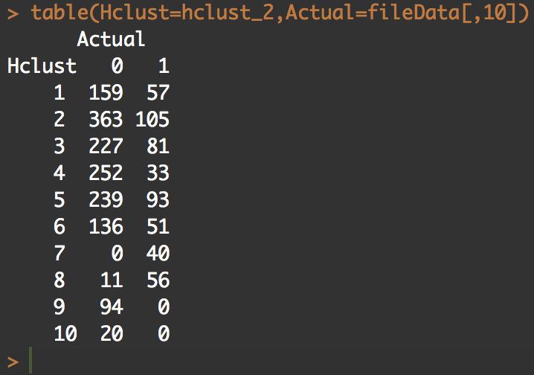
Method = “complete”

Slide 34
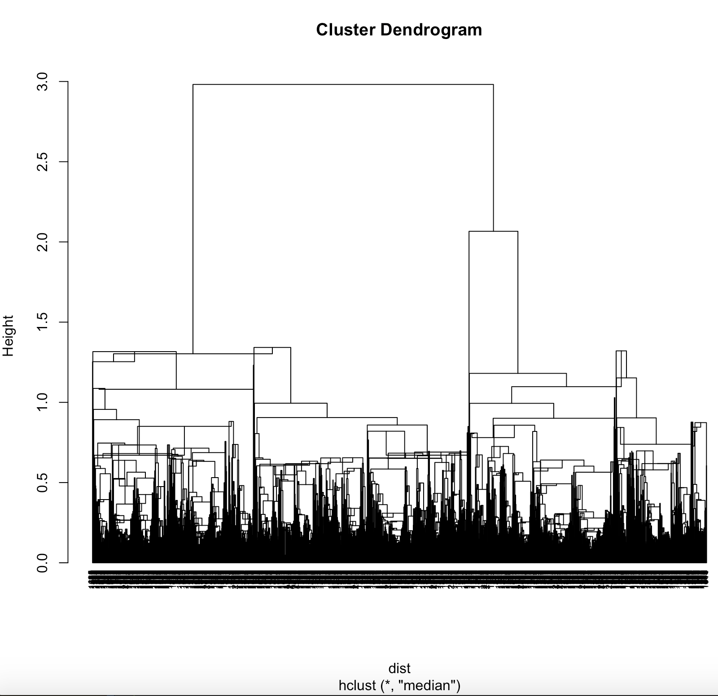


Method = “median”

Slide 35



Method = “mcquitty”

Slide 36





k-means clustering

Slide 37

Welcome to THE MOST
Suitable for all categories business
and personal presentation
ABOUT US

